Slide 1



IN-STORE TESTING SOLUTION
Causal Impact Measurement
WHAT IS IT?
deliverables
Causal Impact is a measurement solution that will isolate the incremental effect of a change to relevant products, brands, or categories. It uses Bayesian time-series models to estimate uplift for several key performance metrics such as sales or households. The Causal Impact method will use weighted combinations of individual control store metrics to develop a synthetic control, eliminating the need for one-to-one test vs control store matching.
Causal Impact can measure both in-store and out-of-store changes, including:
Aisle Design & Navigation
Packaging Innovation
Marketing Activities
Price & Promotion
Assortment
Entire division changes
01/
Test store identification and
sensitivity analysis
Interim test read at the halfway point of the test
Quantified uplift measurement and consumer profiling
02/
03/
PRICE STARTS AT:
Base Test: $40,000
Additional Test Cell: $10,000 (per additional test cell)
1
SENSITIVITY ANALYSIS
with test store identification if necessary
THE 84.51° DIFFERENCE
TEST BEGINS
RICH MEASUREMENT
Our insights are powered by millions of households tracked over time, enabling you to identify who matters most and what they buy with unparalleled granularity.
INTERIM SCORECARD Delivered 2 weeks
following test mid-point
2
FLEXIBILITY IN TEST EXECUTION
Since Causal Impact does not need to match stores one-to-one, measurement remains flexible even when test locations are limited, good control matches are unavailable, or the test has already begun.
TEST CONCLUDES
3
FINAL UPLIFT ANALYSIS
Delivered 4 weeks after conclusion of testing period
© 84.51° 2016 | Confidential

Slide 2

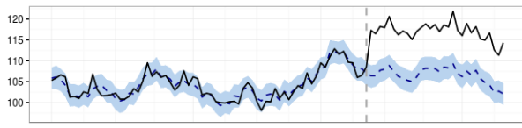
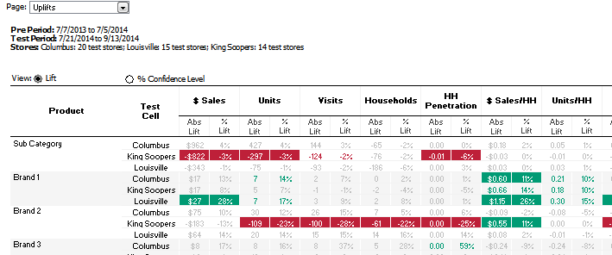
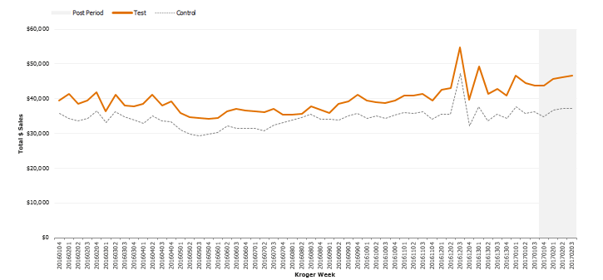
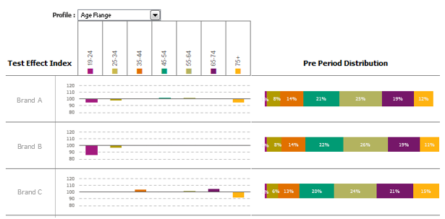

HOW IT WORKS
Sales data from the three-year period leading up to the testing timeframe is evaluated to develop a synthetic control that most closely matches the testing environment. Utilizing several years of pre-period data ensures that post-test measurement accounts for seasonality and general category trends.
Sales in the synthetic control are tracked during the test period, leveraging a weighted combination of actual store sales to determine estimated baseline sales for stores where testing occurs.
Performance in the test stores is compared to the performance of the synthetic control to identify the impact of tested elements (uplift).
1) CREATE A CONTROL
2) GENERATE A FORECAST
3) COMPARE
TO TEST
PRE-PERIOD
TEST PERIOD
SAMPLE OUTPUT
A scorecard of uplifts in test stores vs synthetic control for Sales, Visits, Households, Spend per Trip, Spend per Household, etc.
A time series plot to evaluate weekly performance of the test
A profiling scorecard to evaluate test impact by shopper profile
CONTACT
Contact your 84.51° Client Lead
FirstName.LastName@8451.com
to discuss in further detail.
© 84.51° 2016 | Confidential

